Slide 1
COmmand Design Pattern
Brett Recker
Radwan Albadawi

Slide 2
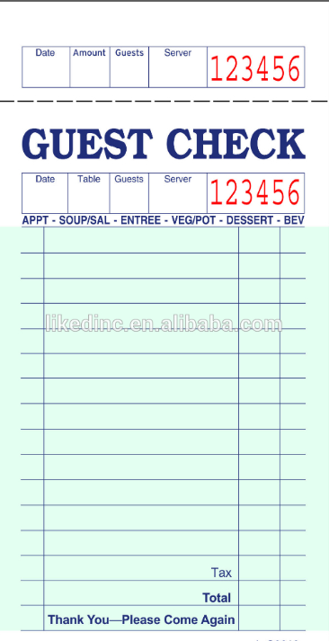
Story
Encapsulate a request as an object letting you parametrize clients with different requests, queue or log requests, and support undoable operations.
Promote "invocation of a method on an object" to full object status
An object-oriented callback
Notes:
The check/order at a restaurant is a good example of this. The waiter/waitress takes an order command from the customer and encapsulates it by writing it on the check. It is then queued to the cook for instructions on what food to make.
The check is not dependent on the menu so it can support commands to cook any food items.

Slide 3
UML Design

Slide 4
Code

Slide 5
Quiz
Notes:
Abstraction and Implementation
No, this is the main benefit of the Bridge Design Pattern.
The Abstraction provides high-level control logic and relies on the implementation object to do the actual low-level work.

Slide 6
Sources
https://sourcemaking.com/design_patterns/command

